Slide 1
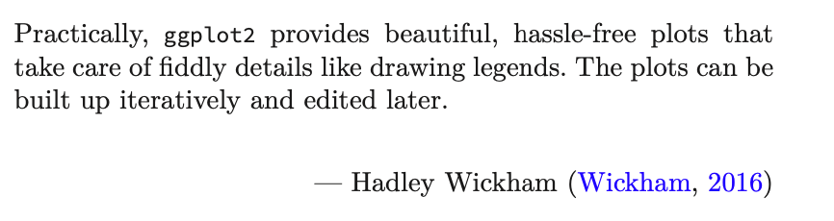
Exploring Operations Research with R: A Workshop
03 – ggplot2
https://github.com/JimDuggan/Exploring-OR-with-R-Workshop

Slide 2
Topics Overview
Topic | Description | ~Timing
1 | Introduction to R and Posit Cloud | 10 mins
2 | Storing data using data frames / tibbles | 10 mins
3 | Visualisation with ggplot2 | 20 mins
4 | Data transformation with dplyr | 20 mins
5 | Using R with OR – Four Examples | 30 mins

Slide 3
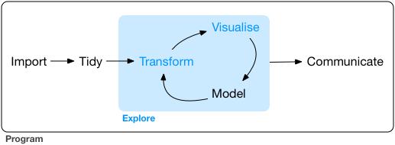
Data Exploration
“Data exploration is the art of looking at your data, rapidly generating hypotheses, quickly testing them, then repeating again and again and again.” (Wickham and Grolemund 2017).

Slide 4
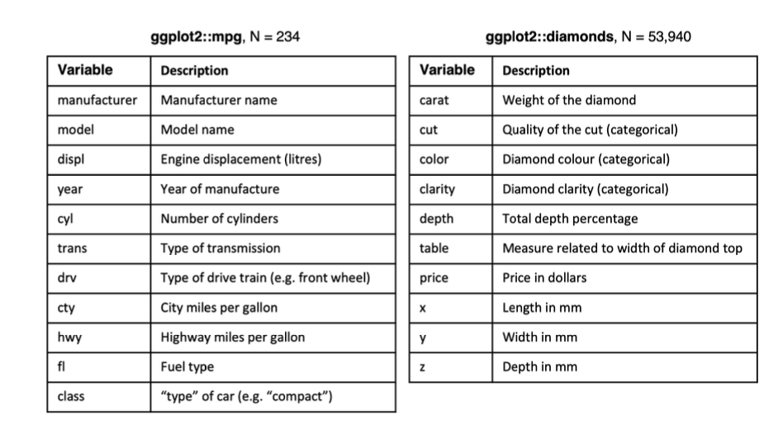
ggplot2
Layered grammar of graphics, enables us to concisely describe the components of a graphic.
Benefits:
plots can be designed in a layered manner (+ operator)
a wide range of plots can be generated to support decision analysis, including scatterplots, histograms and time series charts
charts can be developed rapidly, and this support an iterative process of decision support

Slide 5
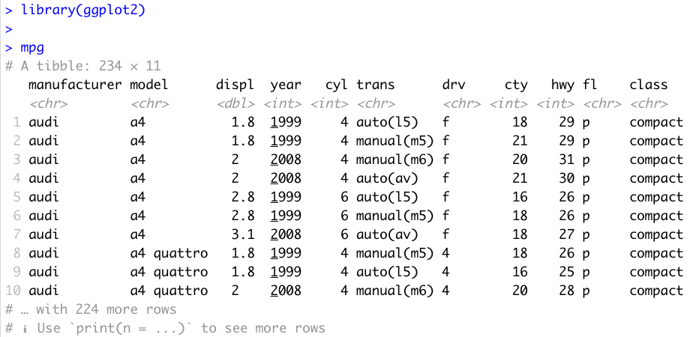
Data Visualisation with ggplot2
“The simple graph has brought more information to the data analyst’s mind that any other device.” – John Tukey

Slide 6
First Steps
Generate a first graph to help answer the following question:
Do cars with big engines use more fuel than cars with small engines
What might the relationship between engine size and fuel efficiency look like?
Need to draw a scatter plot

Slide 7
Selecting data
Among the variables are:
displ, a car’s engine size in litres
hwy, a car’s fuel efficiency on the highway in miles per gallon

Slide 8
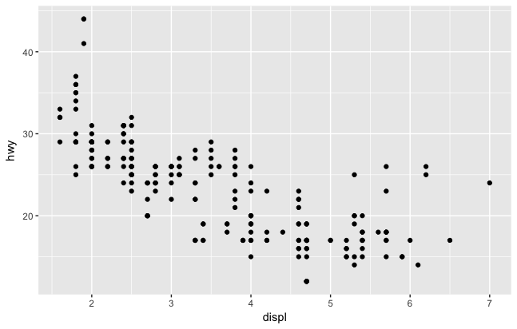

Creating a ggplot

Slide 9
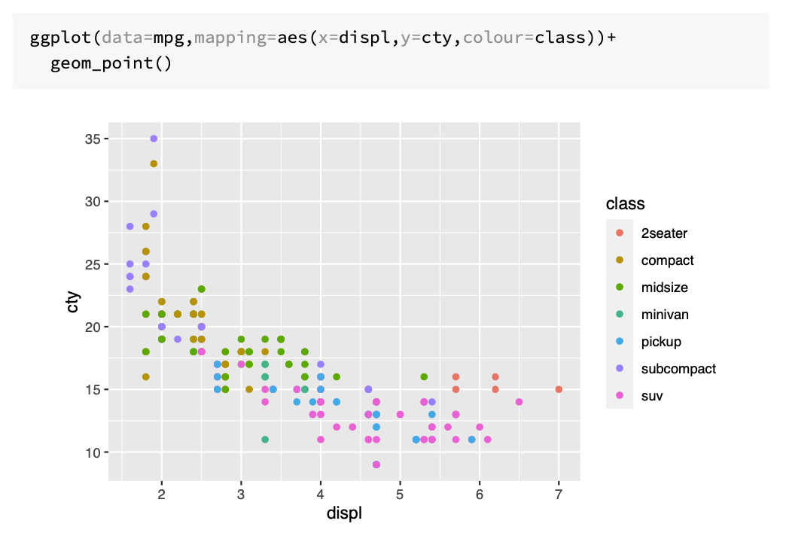

Slide 10
Customising Plot Appearance with lab()
Argument | Role
title | provides an overall title text for the plot
subtitle | adds a subtitle text
colour | allows you to specify the legend name for the colour attribute
caption | inserts text on the lower right hand side of your plot
size | allows you to name the size attribute
x | name the x-axis
y | name the y-axis
tag | text for tag label for top-left of plot

Slide 11
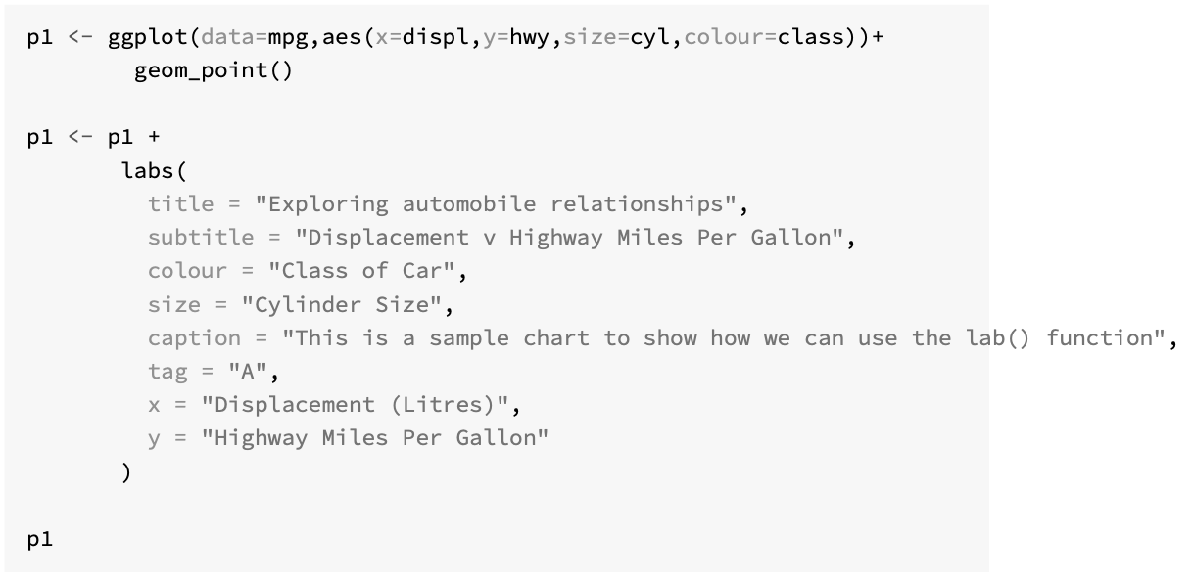

Slide 12
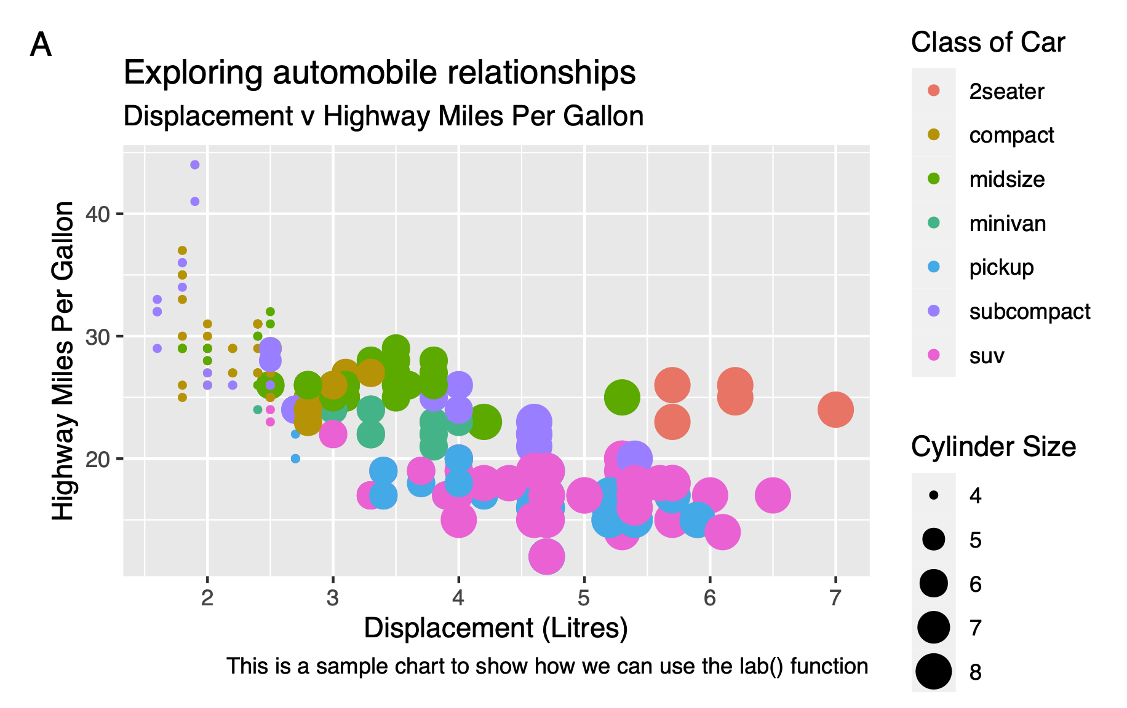

Slide 13
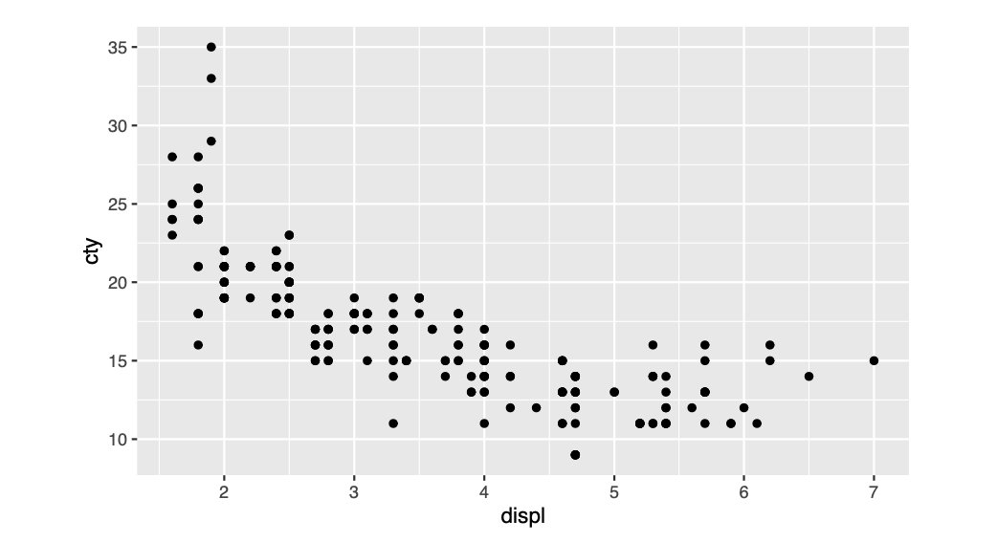
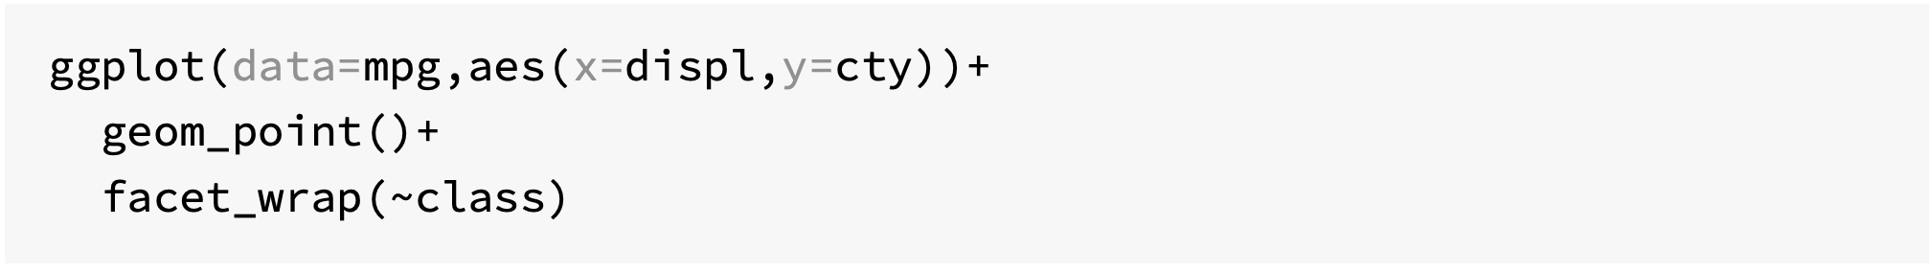
Subplots with Facets

Slide 14
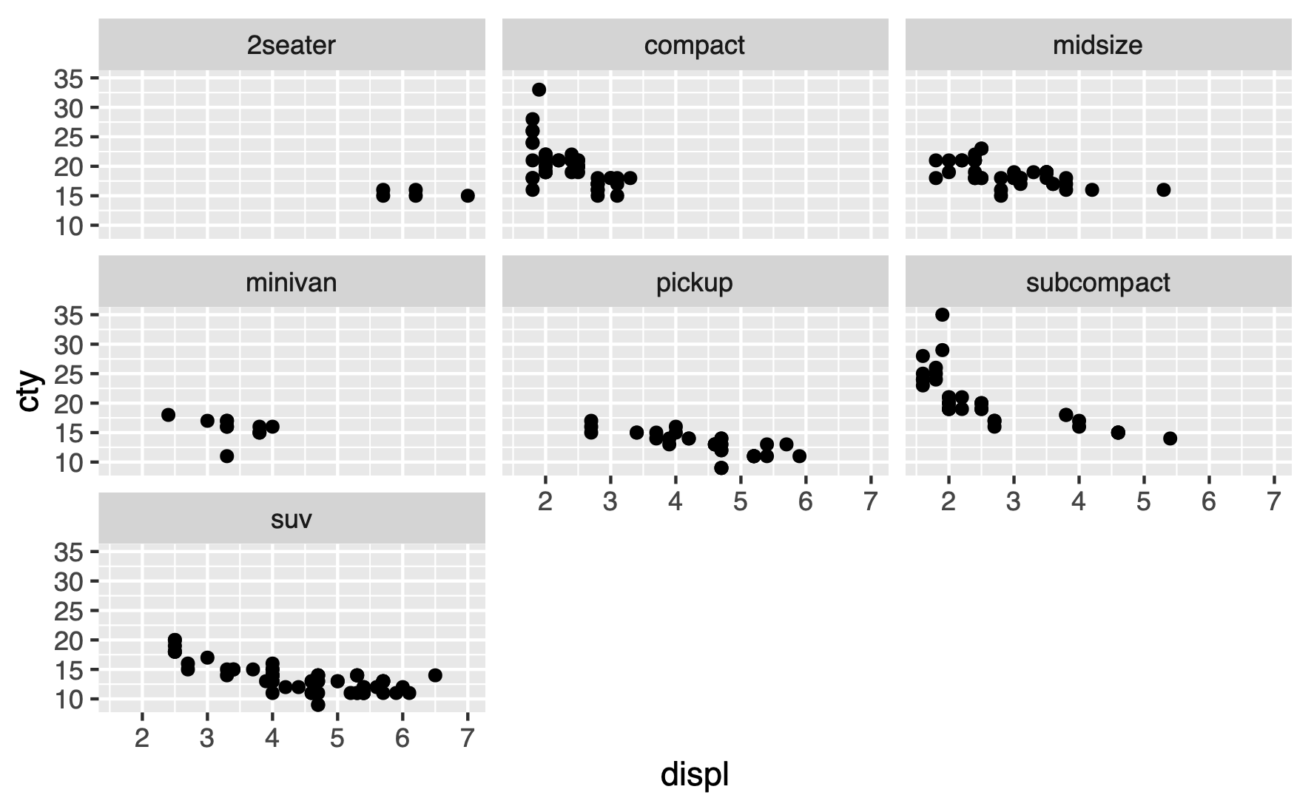

Slide 15
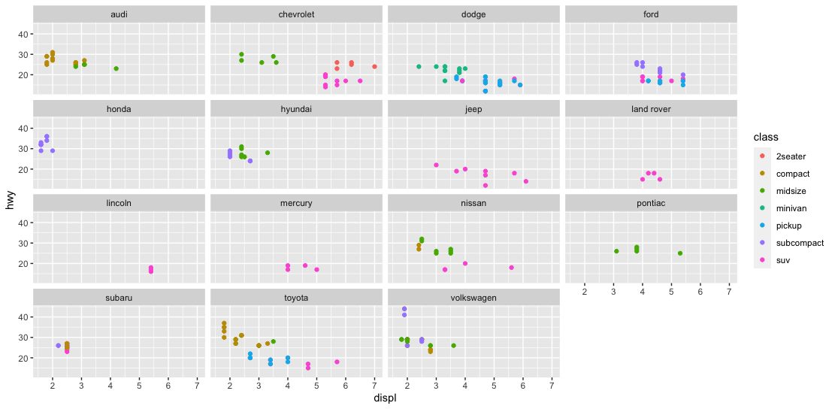
Challenge
Generate the following scatter plot (displ v hwy) from the tibble mpg (ggplot2 library)

Slide 16
Statistical Transformations
Many graphs, like scatterplots, plot the raw values of the dataset
However, other graphs (e.g. bar charts) calculate new values to plot
Bar charts, histograms and frequency polygons bin your data and plot bin counts, the number of points that fall in each bin
Smoothers fit a model to your data and the plot predictions from the model
Boxplots compute a robust summary of the distribution and display a specially formatted box

Slide 17
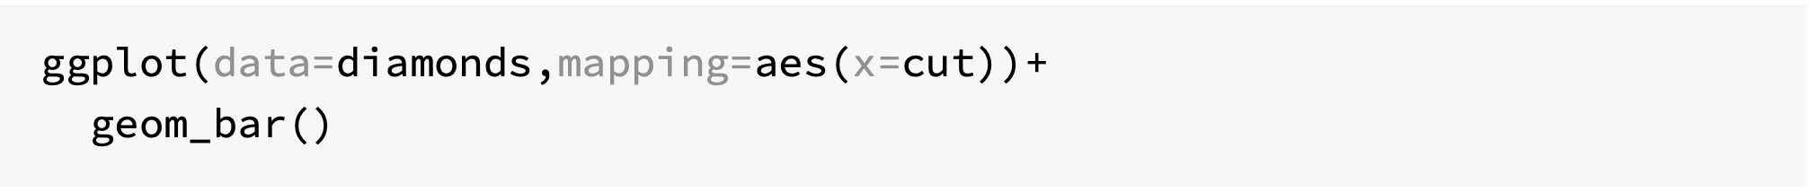
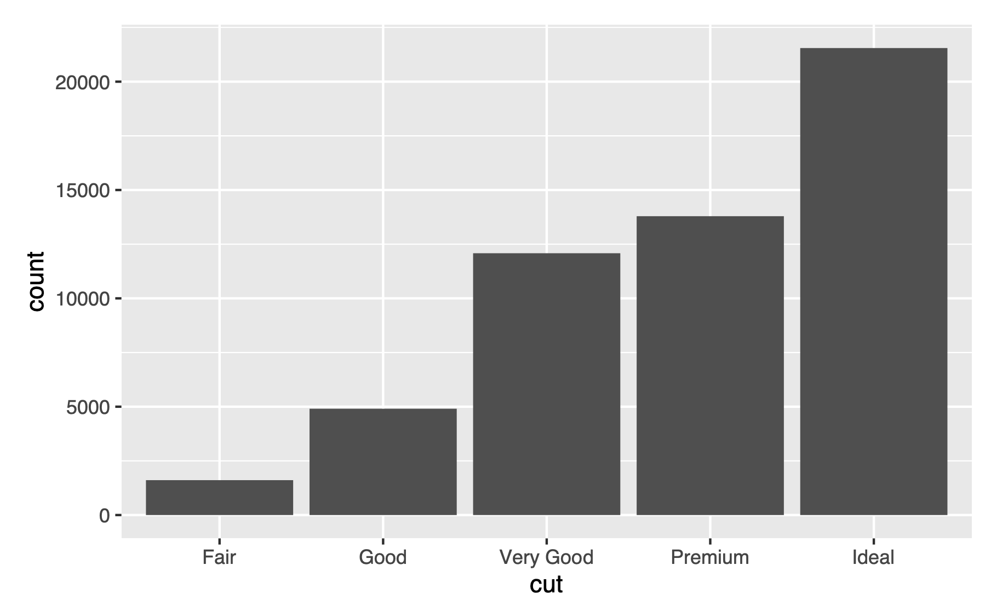

Slide 18
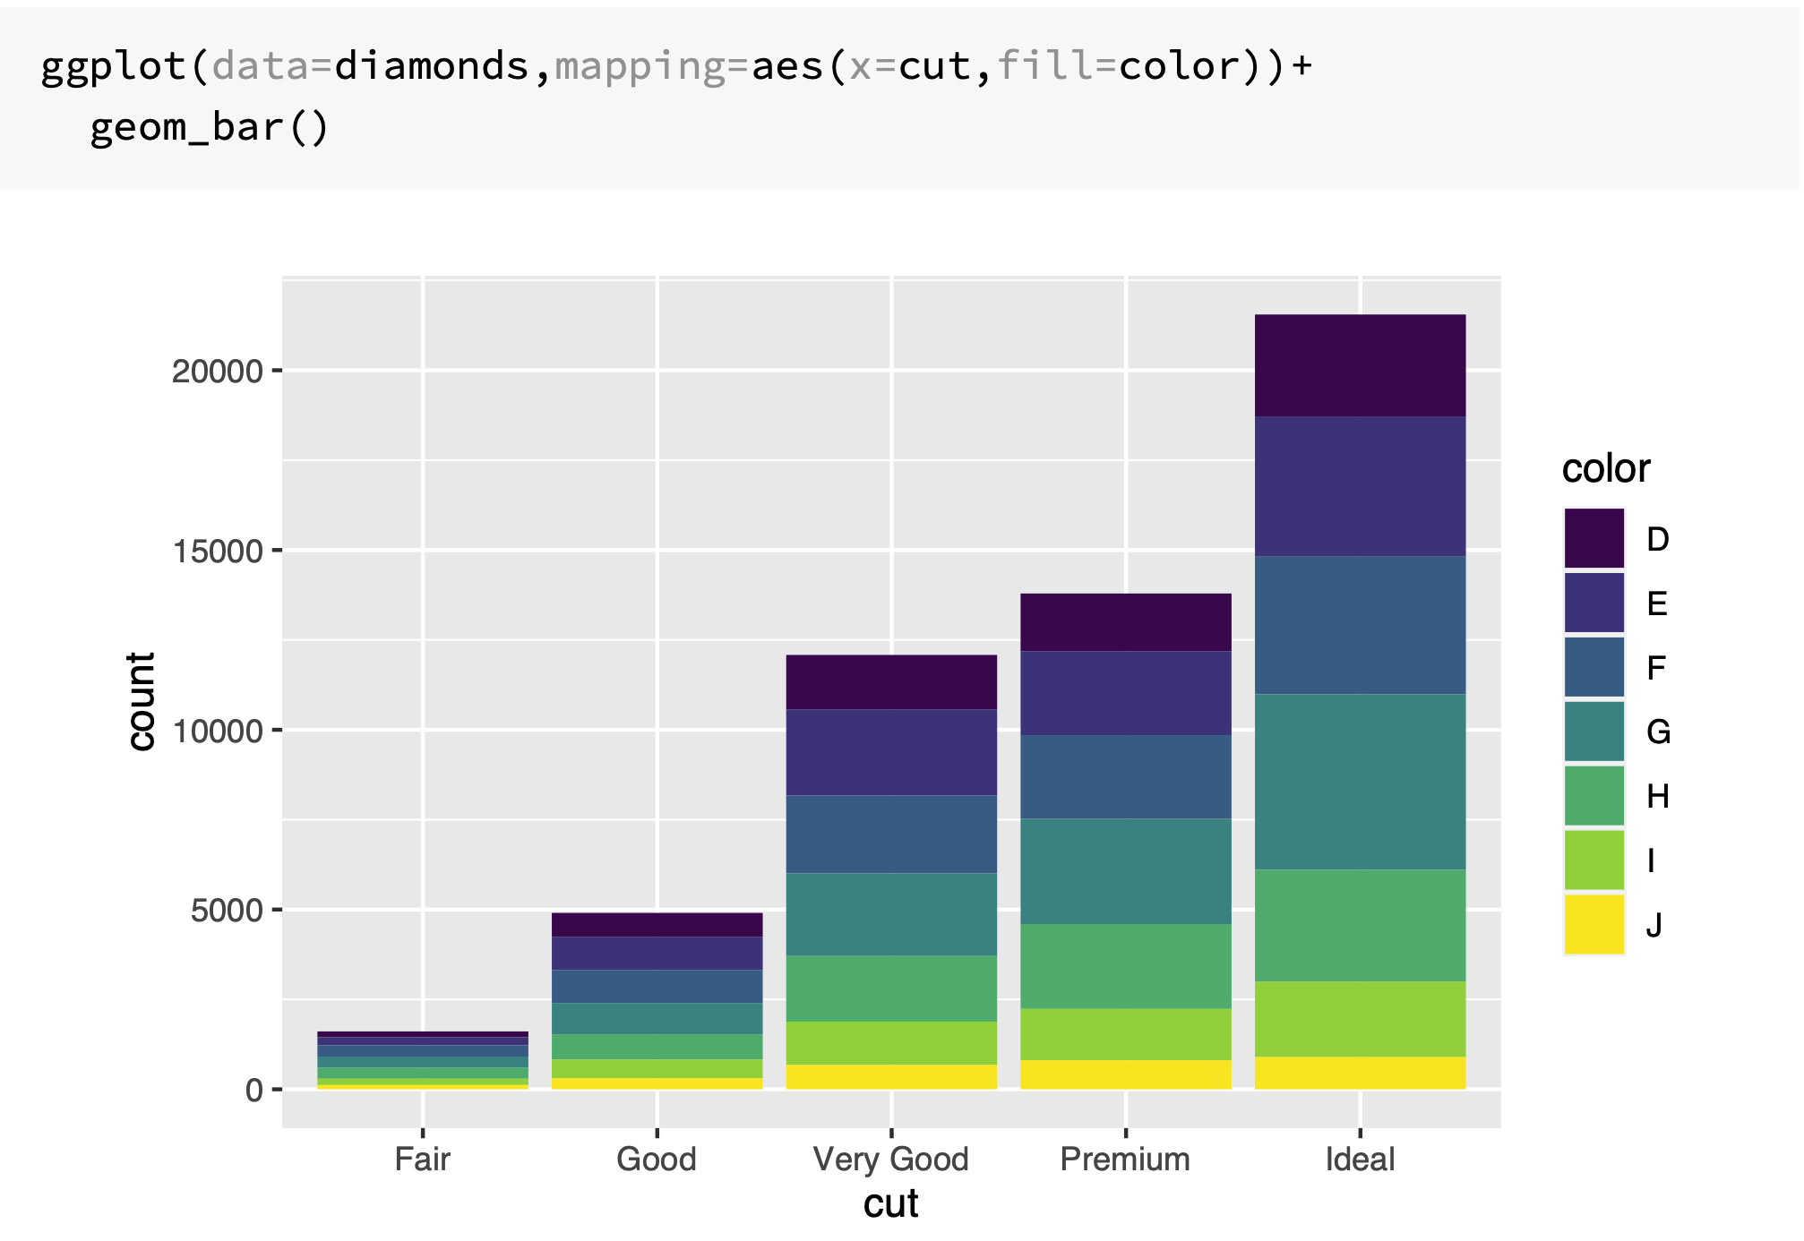

Slide 19
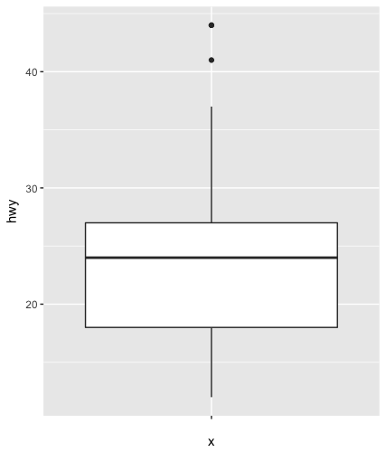
Boxplot
Display the distribution of a continuous variable broken down by a categorical variable
Box that stretches from the 25th to 75th percentile a distance known as the interquartile range (IRQ)
Median in the middle of box
Points outside more that 1.5 times the IQR from either edge of the box are displayed (outliers)
Whisker extends to the farthest non-outlier point in the distribution

Slide 20
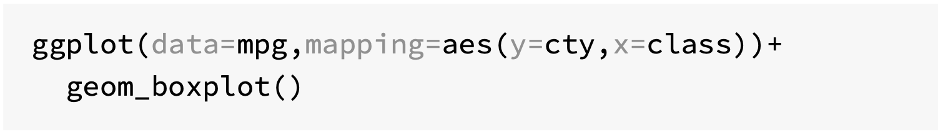
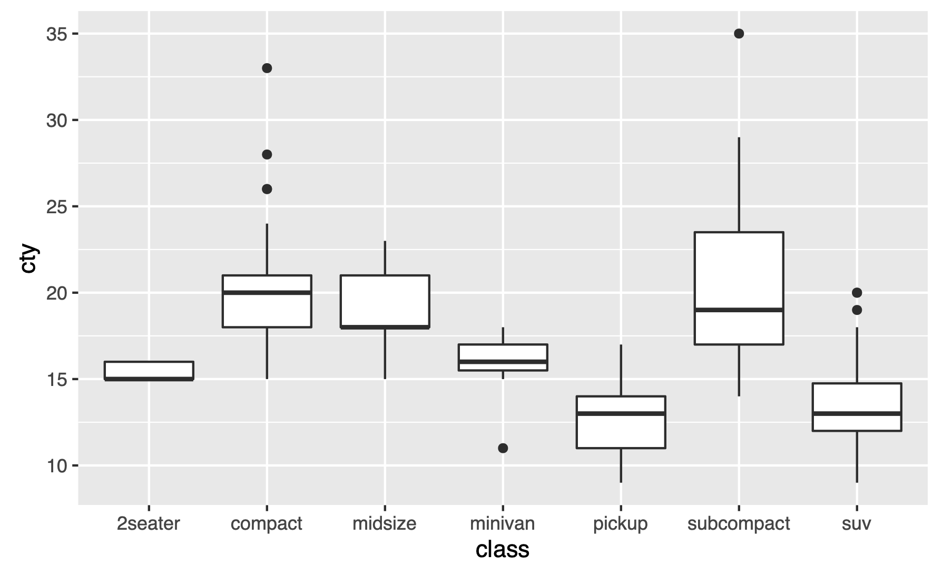

Slide 21
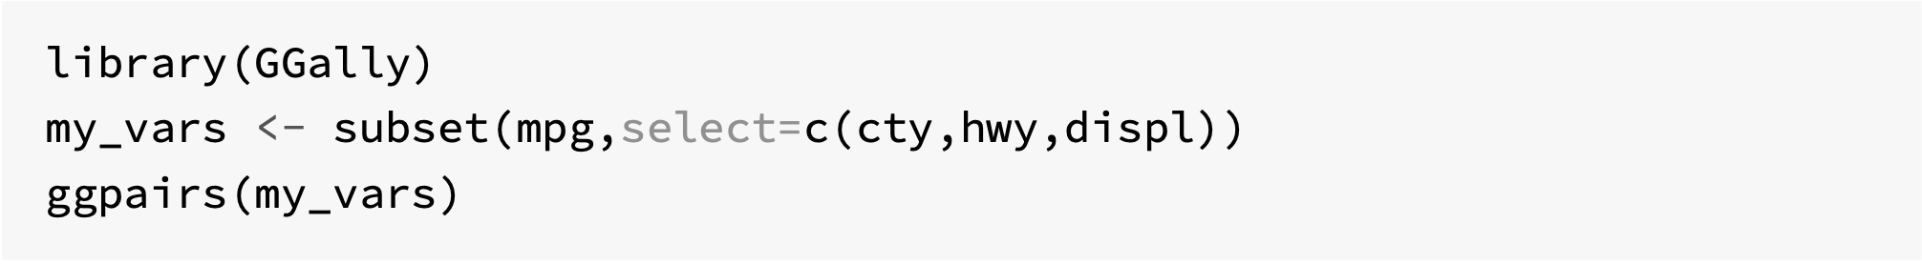
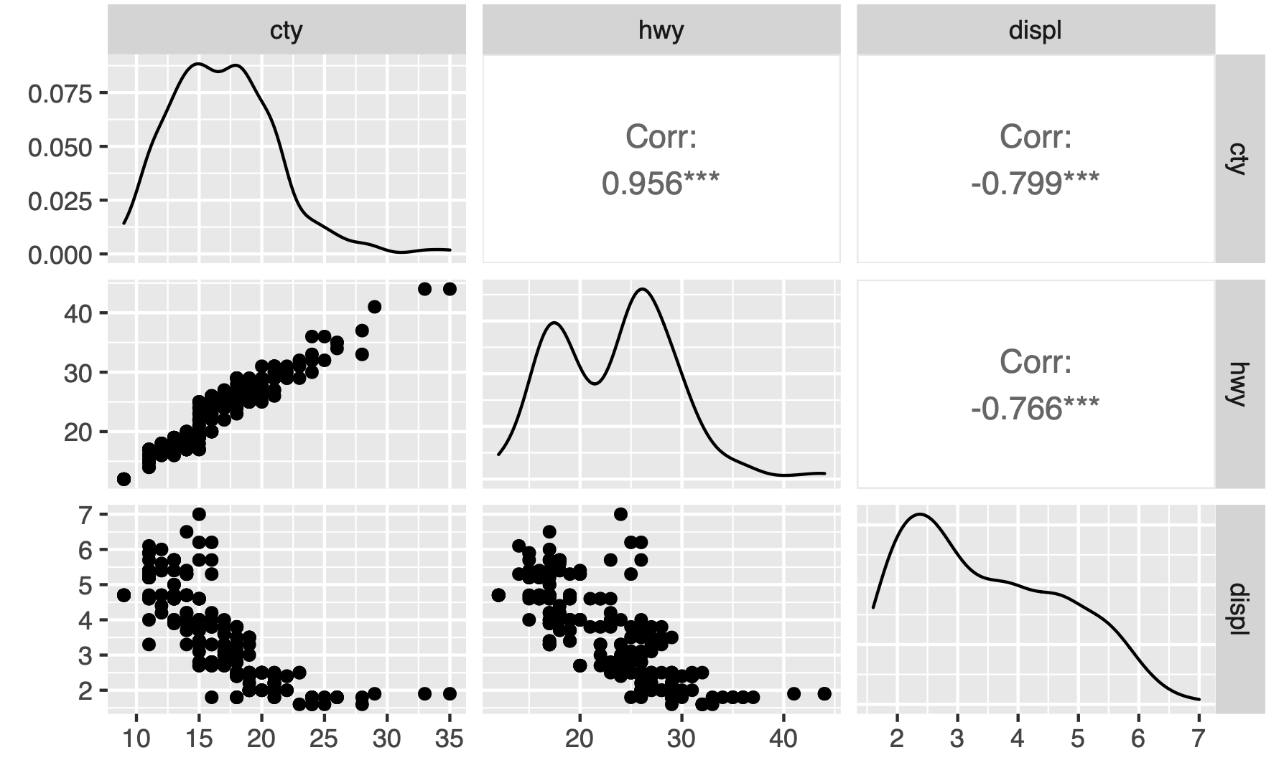
Covariation with ggpairs()

Slide 22
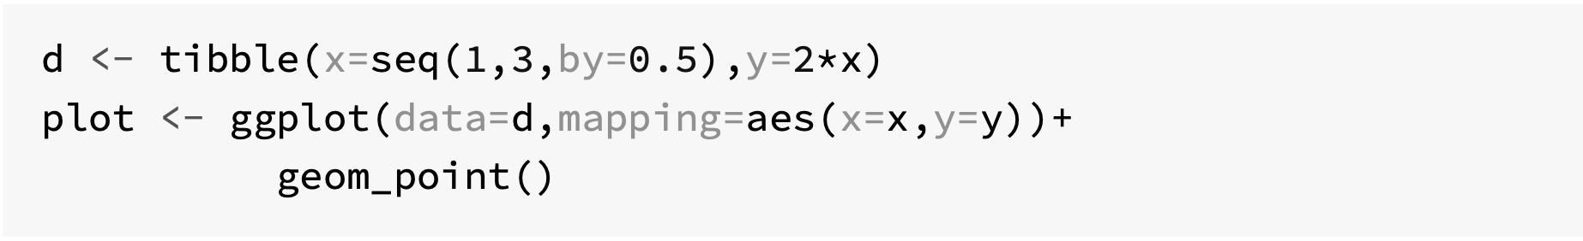
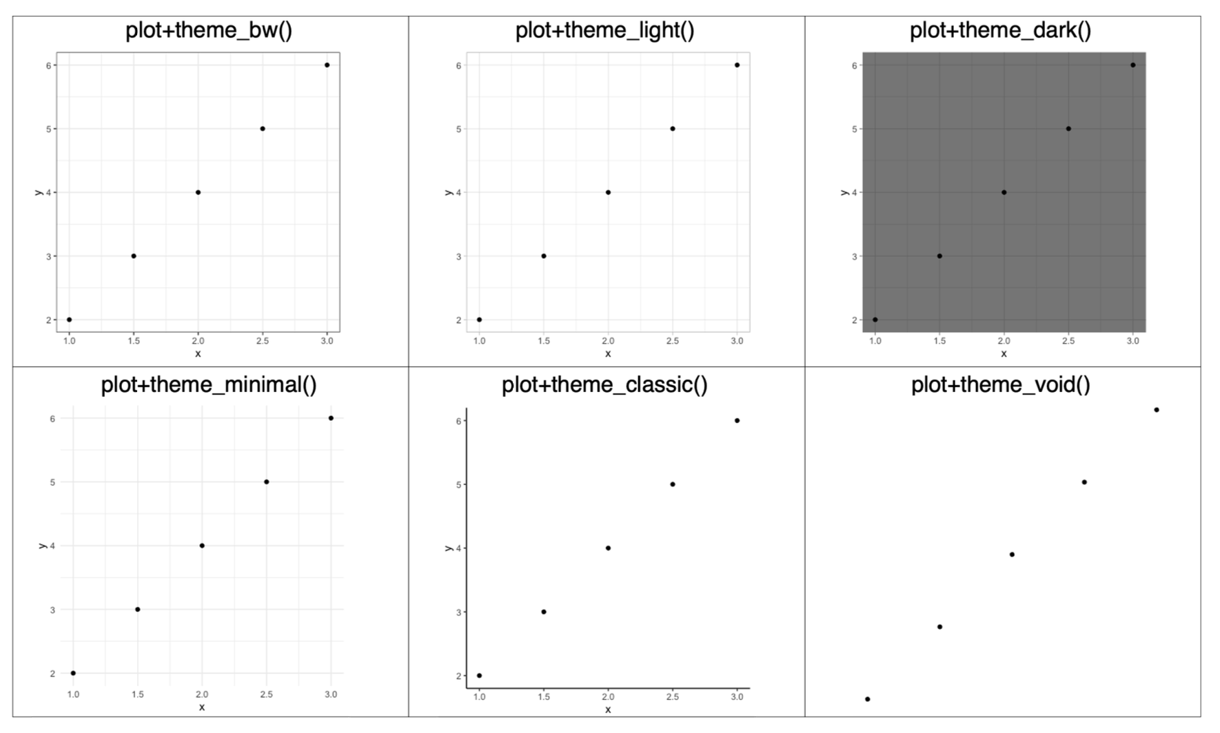
Ready to use themes

Slide 23
Useful geoms
Geom | Purpose
geom_smooth() | Fits a smoother to data and displays the smooth and its standard error
geom_boxplot() | Produces a box-and-whisker plot to summarise the distribution of a set of points
geom_histogram() geom_freqpoly() | Shows the distribution of continuous variables
geom_bar() | Shows the distribution of categorical variables
geom_path() geom_line() | Draws lines between data points
geom_area() | Draws an area plot, which is a line plot filled to the y-axis. Multiple groups will be stacked upon each other
geom_rect() geom_tile() geom_raster() | Draw rectangles
geom_polygon() | Draws polygons, which are filled paths.

Slide 24
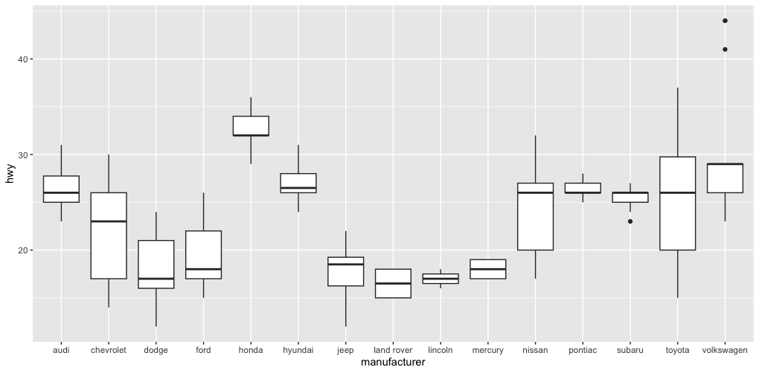
Challenge
Generate the following box plot (hwy by manufacturer) from mpg.

Slide 25
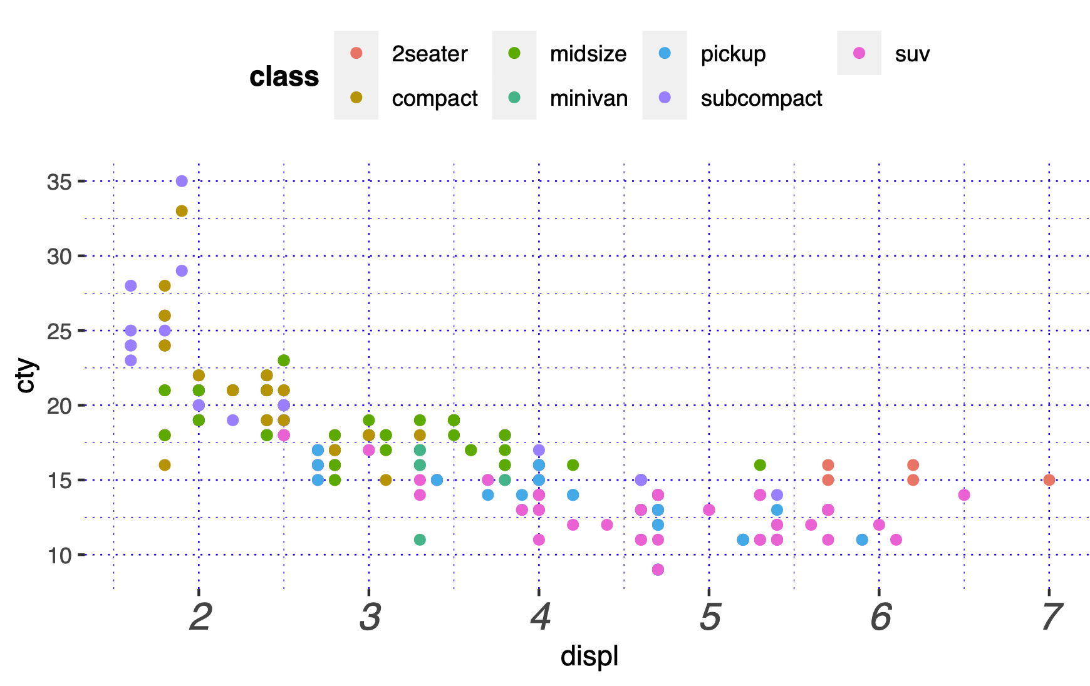
Summary
Layered grammar of graphics, enables us to concisely describe the components of a graphic.
Benefits:
plots can be designed in a layered manner (+ operator)
a wide range of plots can be generated to support decision analysis, including scatterplots, histograms and time series charts
charts can be developed rapidly, and this support an iterative process of decision support

